Slide 1
Avenues in IT
Data Science and Deep Learning
SOCET, Ahmedabad
Joy Bose

Slide 2
Deep learning Vs traditional programming
Traditional Programming | Machine Learning / Deep Learning
Fixed sequence of instructions + data | Adapts with new data without code change
Concept of model is hidden/ static | Generates/updates machine learning model with data
Precise, deterministic output | Output within bounds of error
Example: Rule based handwriting/ face recognition or CoViD prediction | Example: Handwriting/ face recognition or CoVID prediction based on dataset
Driven by fixed rules | Driven by data
Only one step to execute | Training step + prediction step
Old Data
(with/without
labels)
Machine Learning
Program
(train)
Model
Instructions
Traditional Computer Program
Output
Data
Updated Model
Machine Learning
Program
(predict)
Output Predictions
New Data

Slide 3

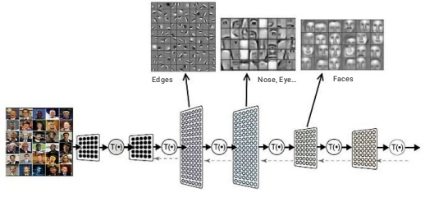
Deep Learning: Neural Network
Multiple layers of artificial ‘neurons’, each neuron performs a summation of its inputs and fires an output value, which is input to the next layer
“Deep” → Many layers of neurons

Slide 4
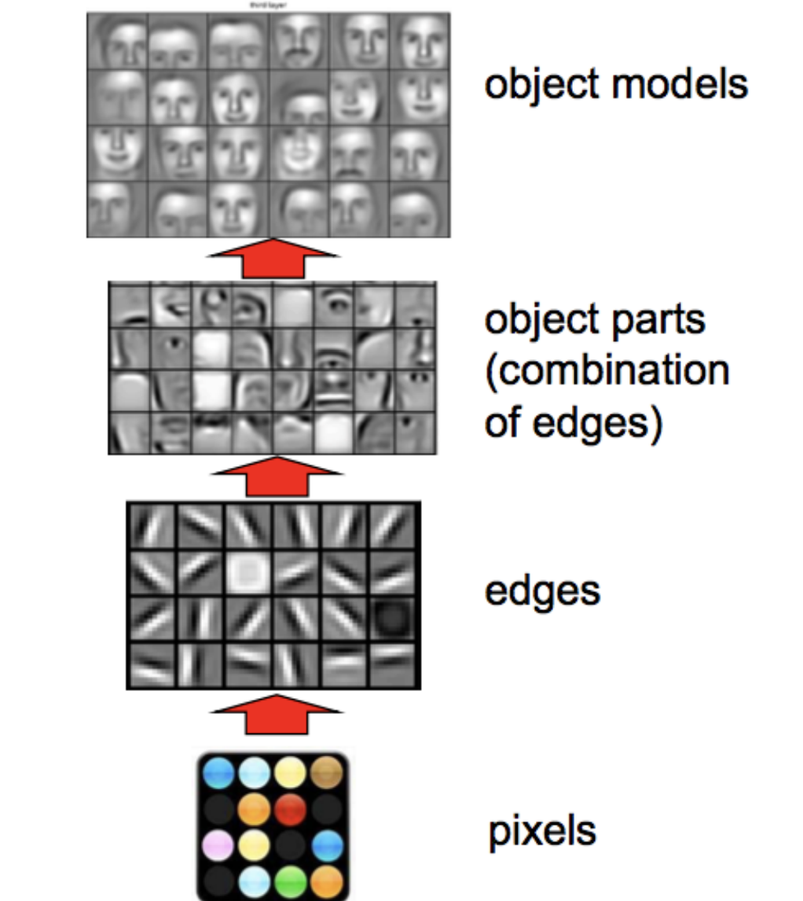
Deep Learning : Learn Representations

Slide 5
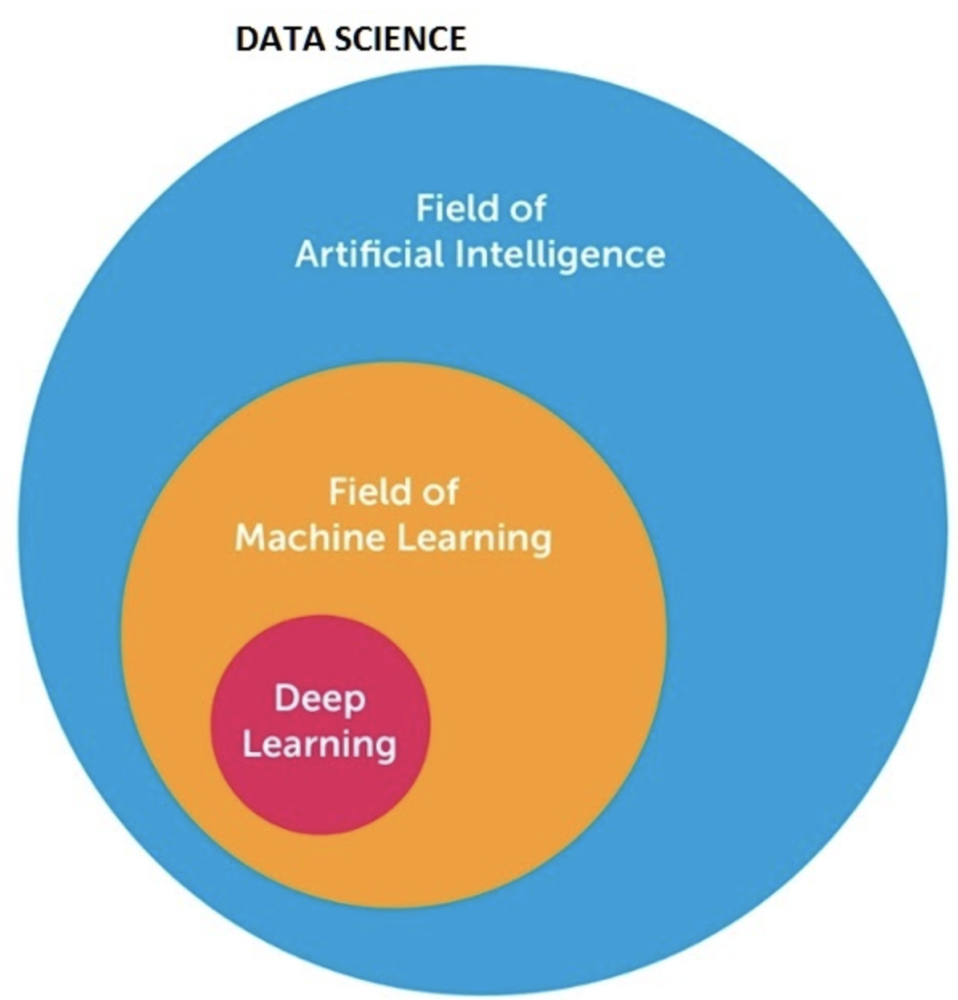
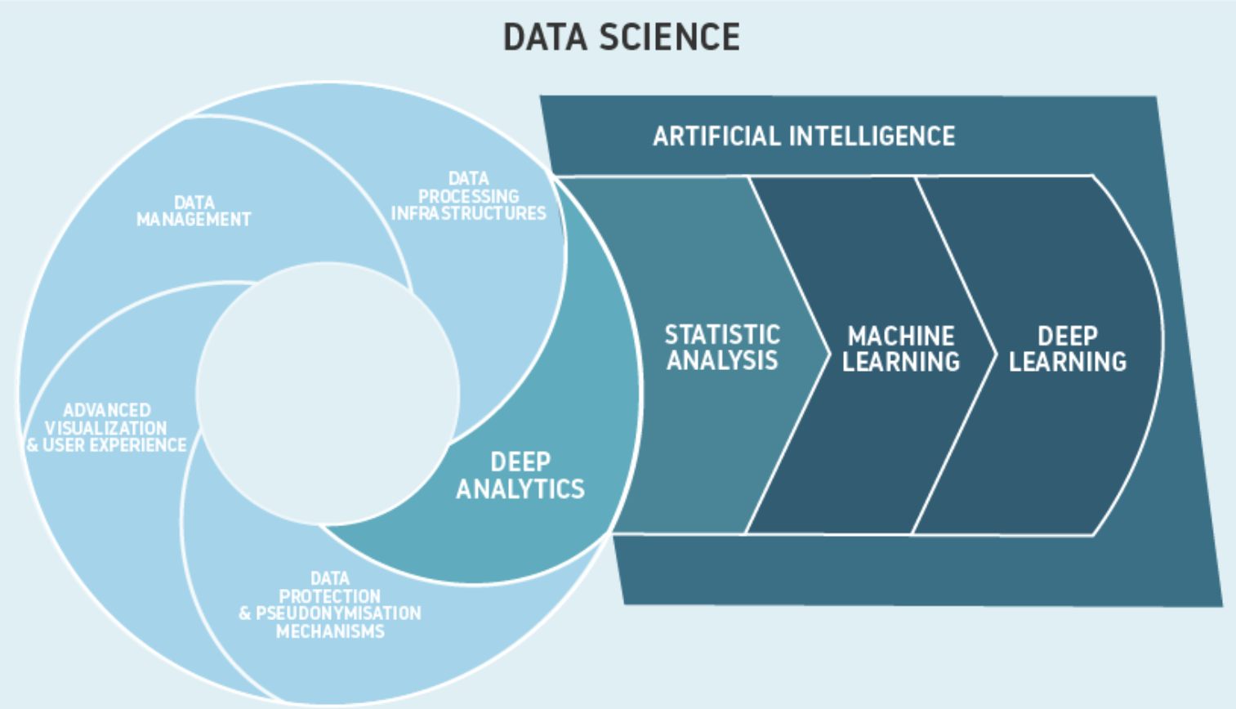
Relation between different fields in ML and DS

Slide 6
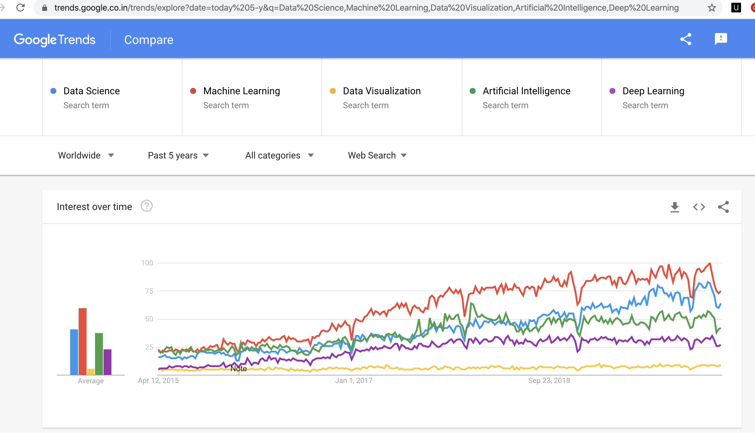
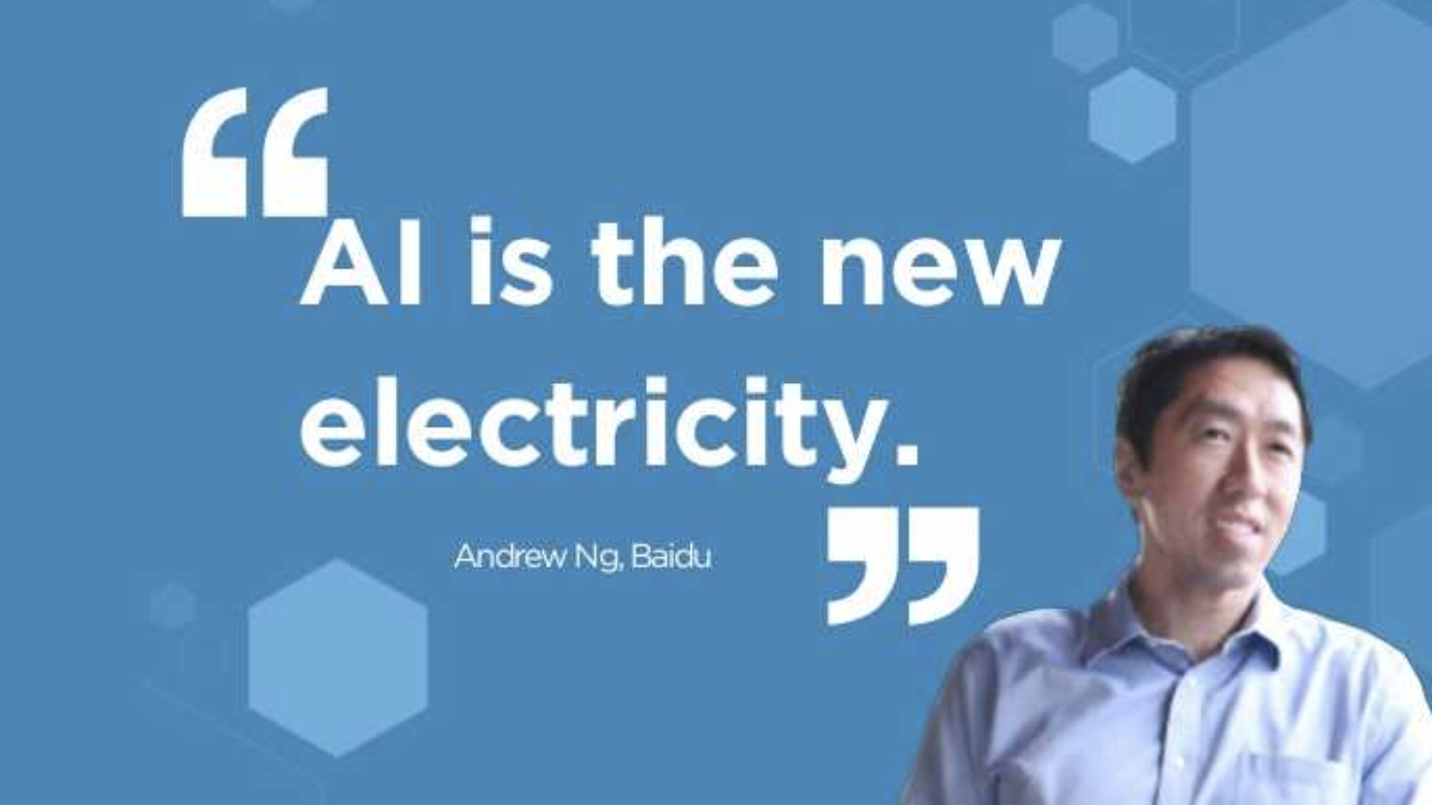
Google Trends: Data Science terms

Slide 7
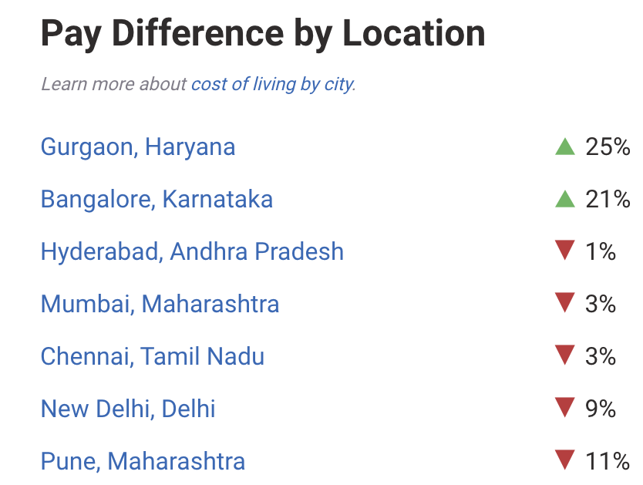
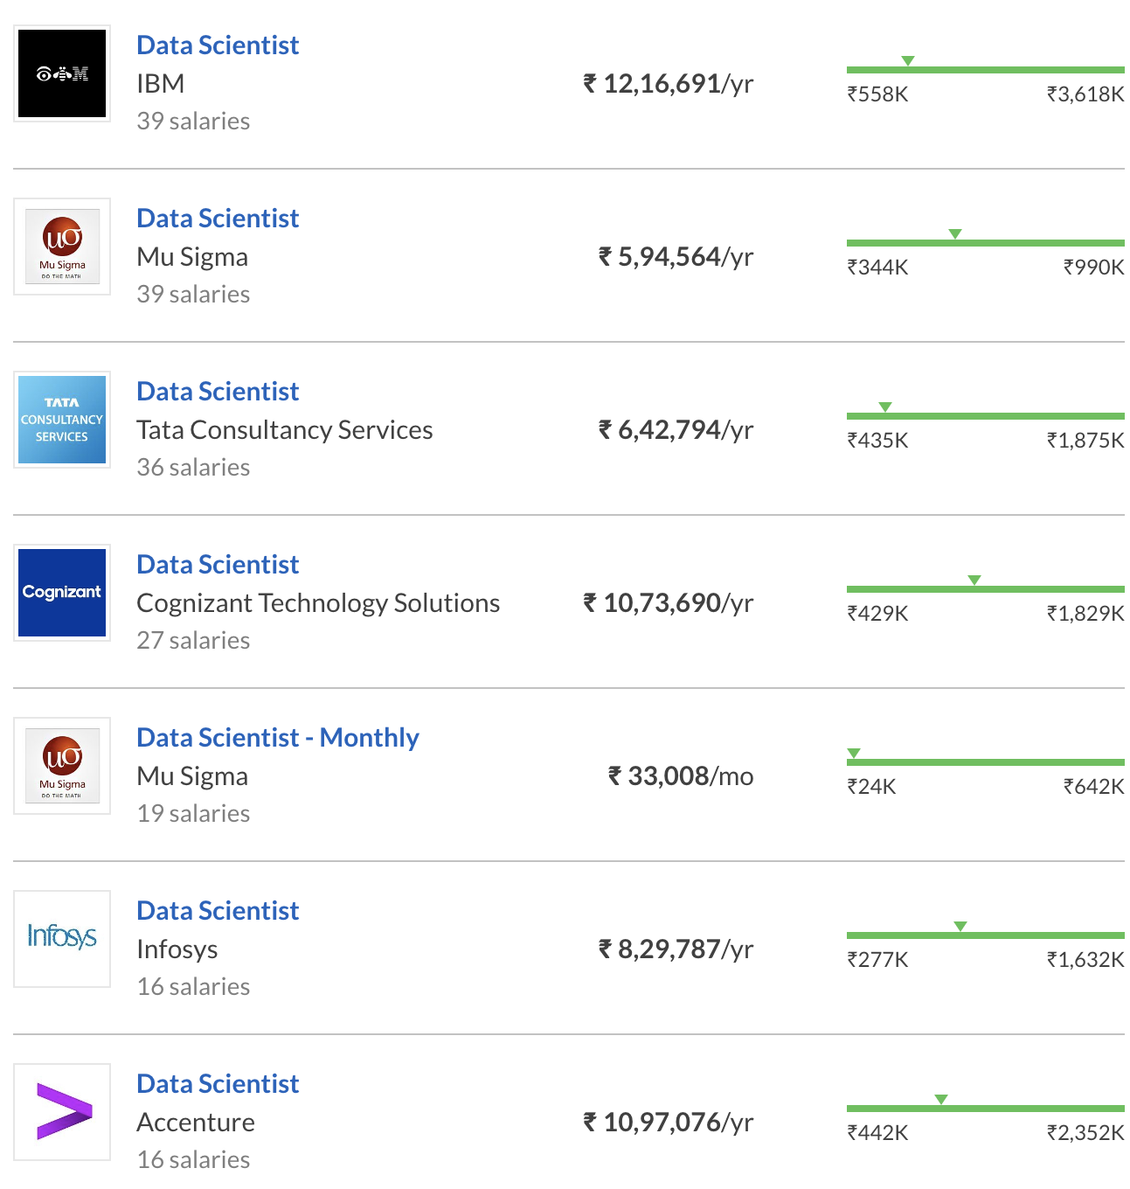
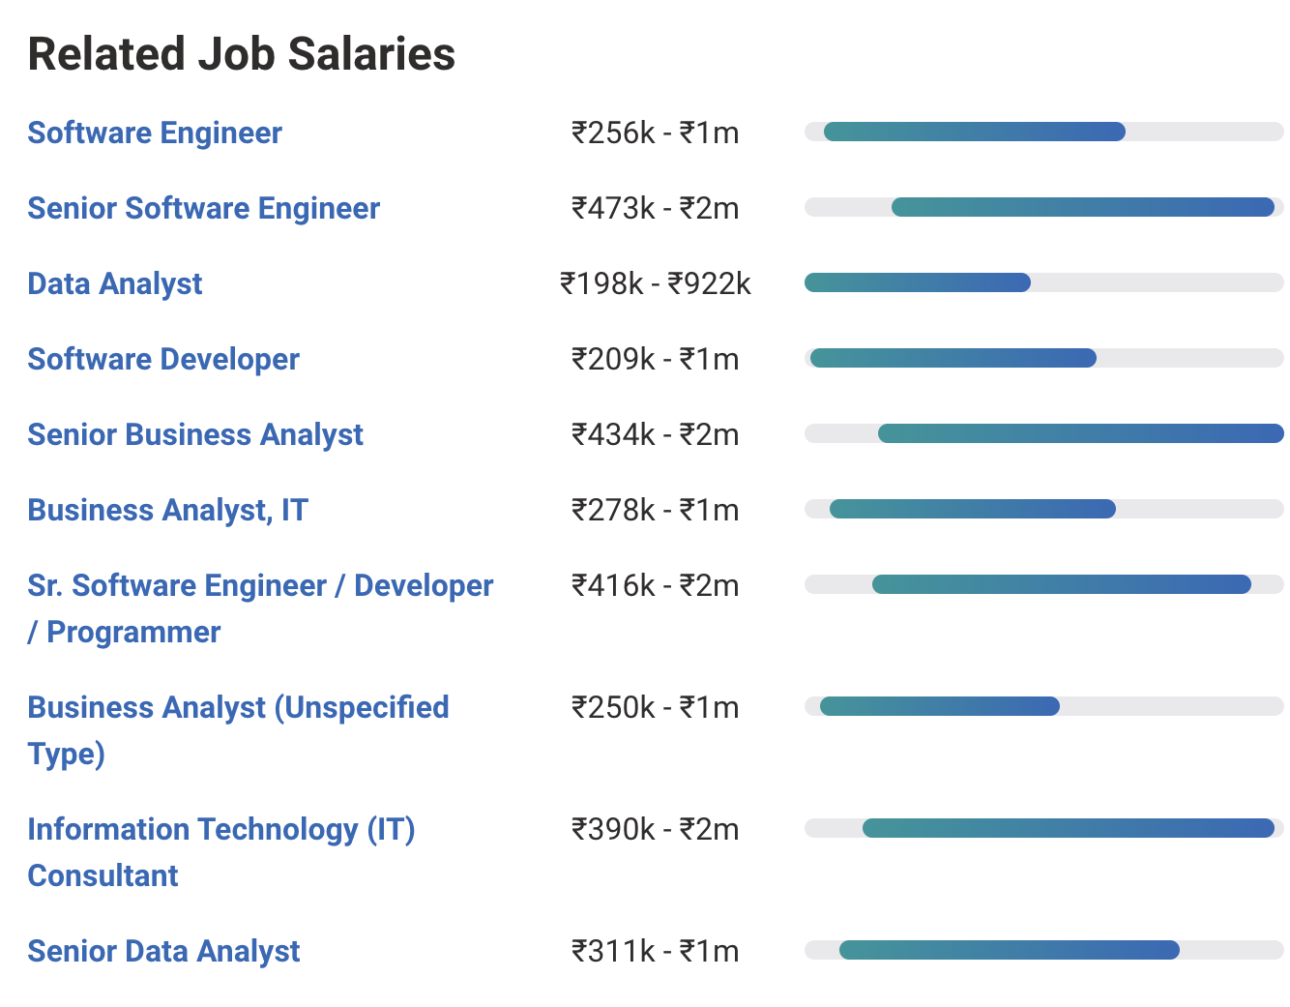
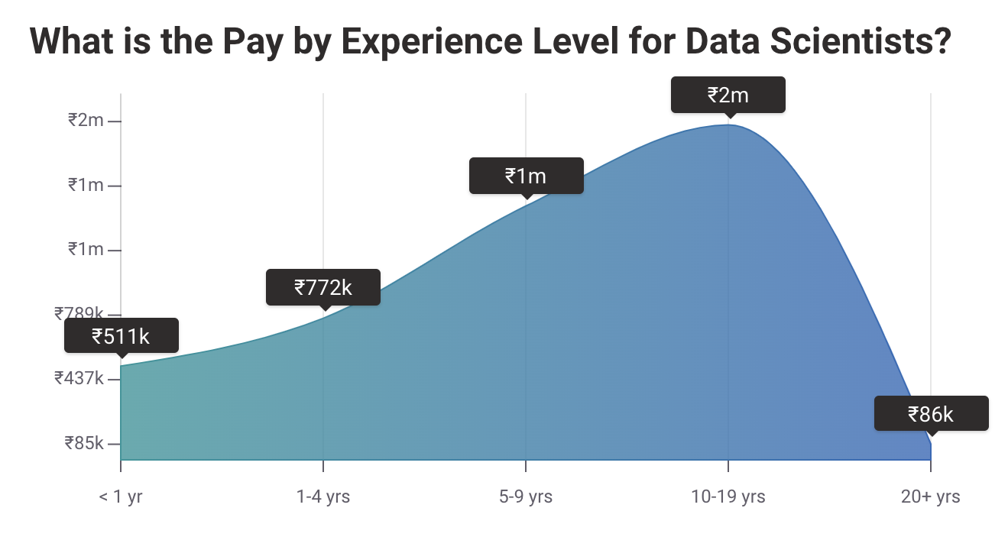
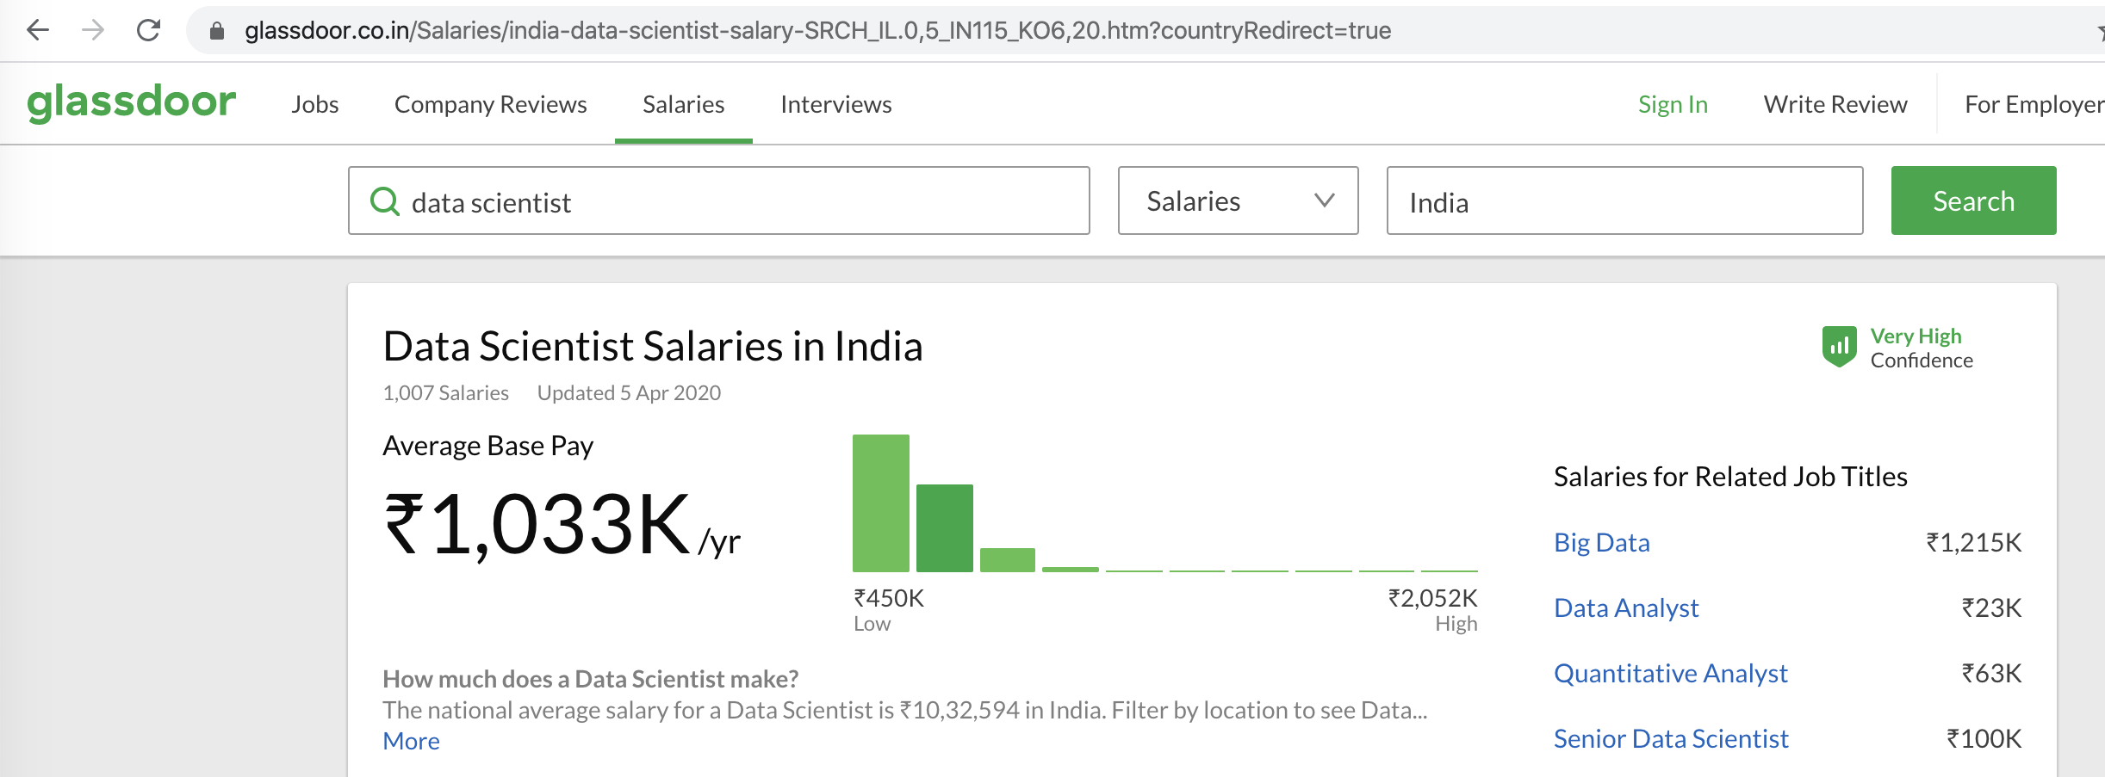
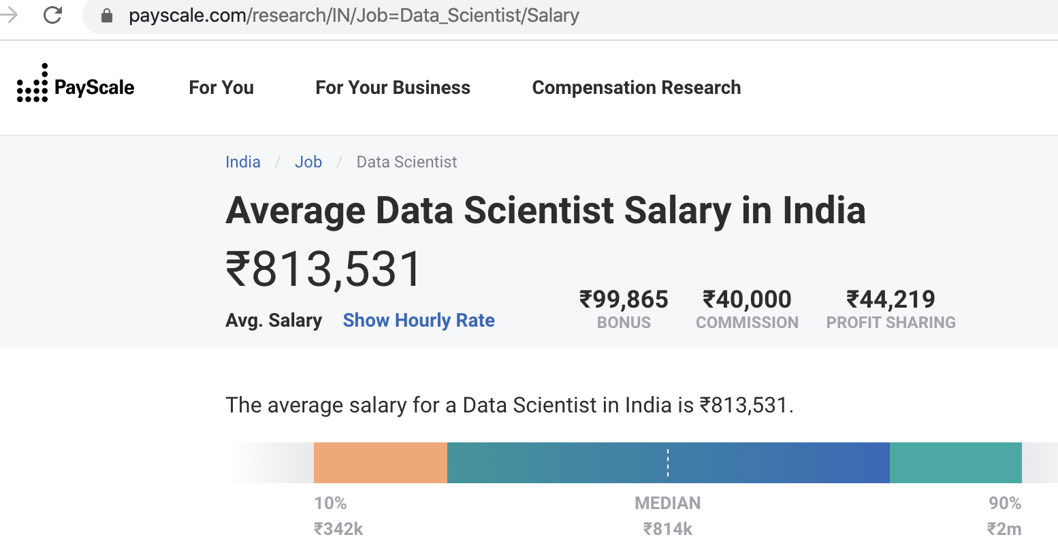
Careers in Data Science
(Glassdoor, Payscale)

Slide 8
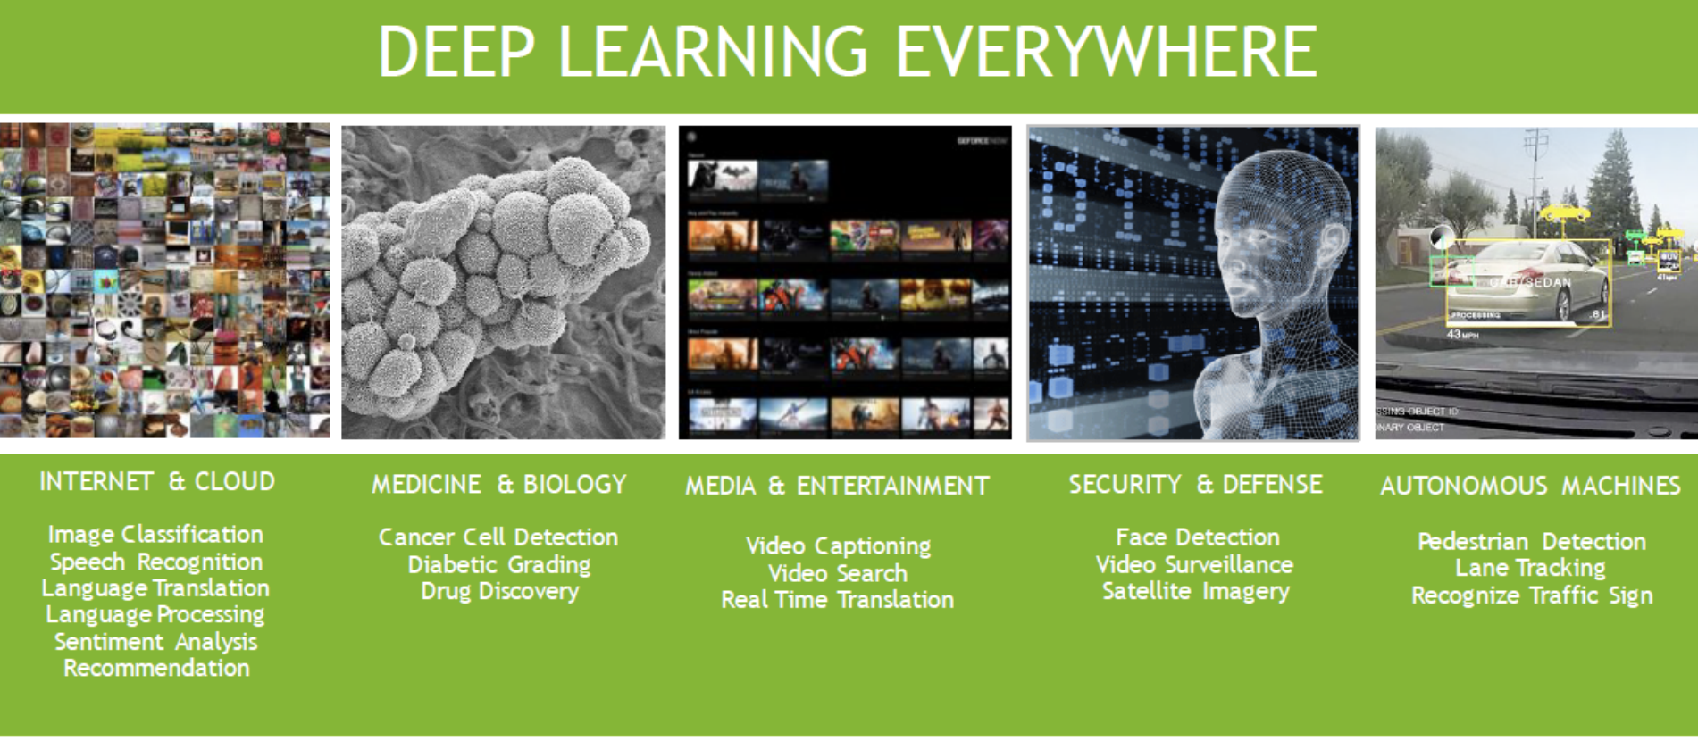
Applications of Deep Learning

Slide 9
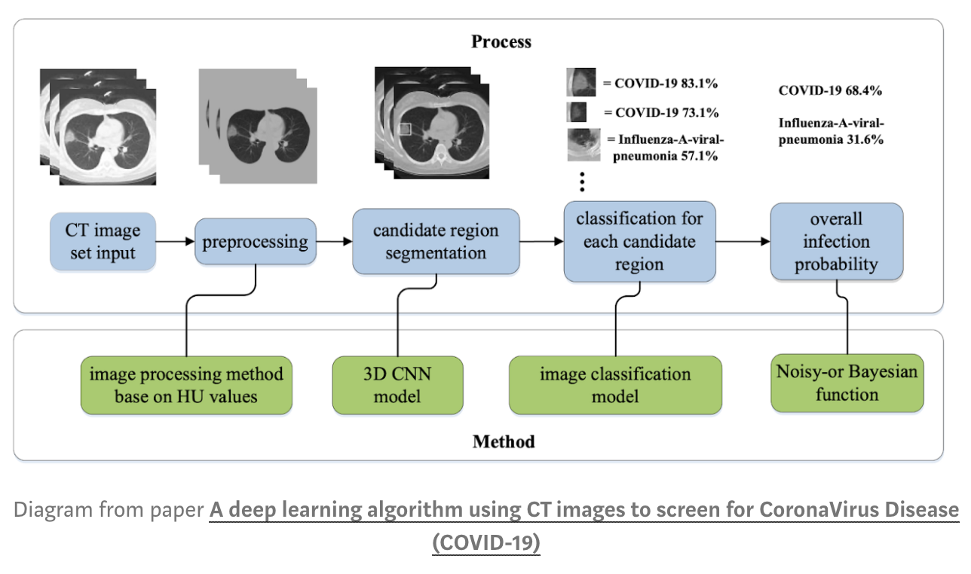

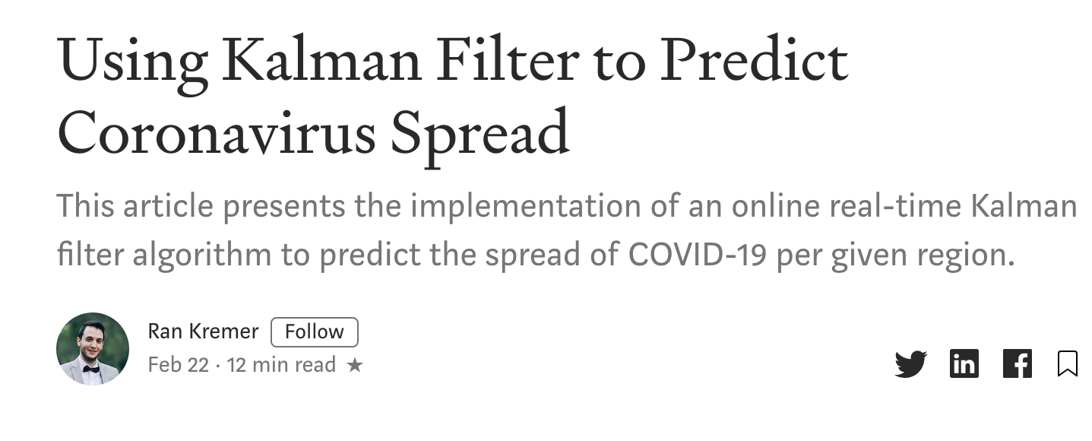
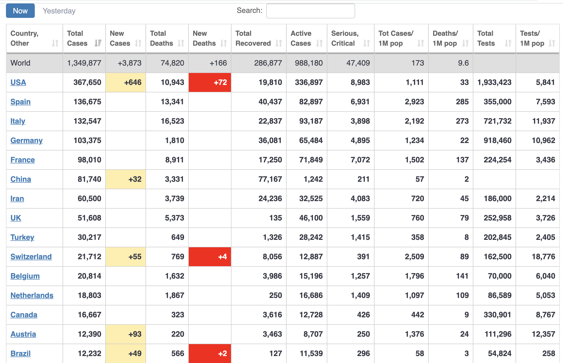
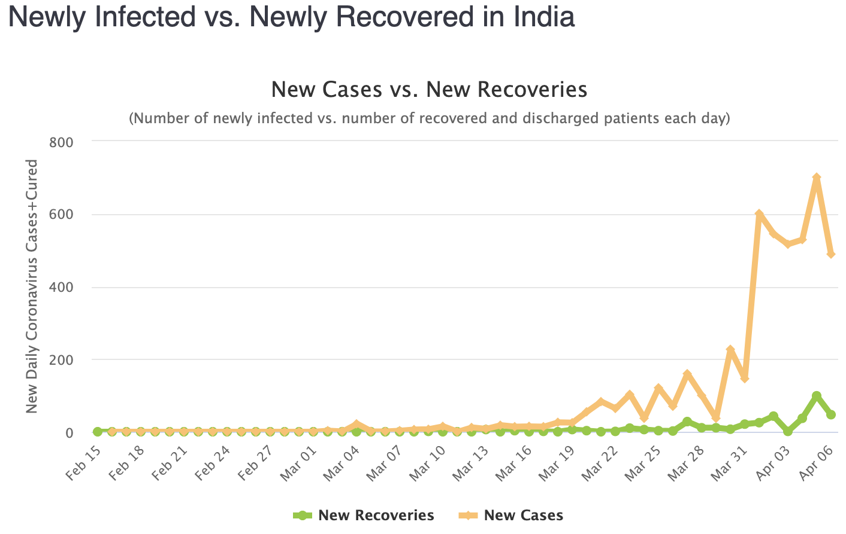
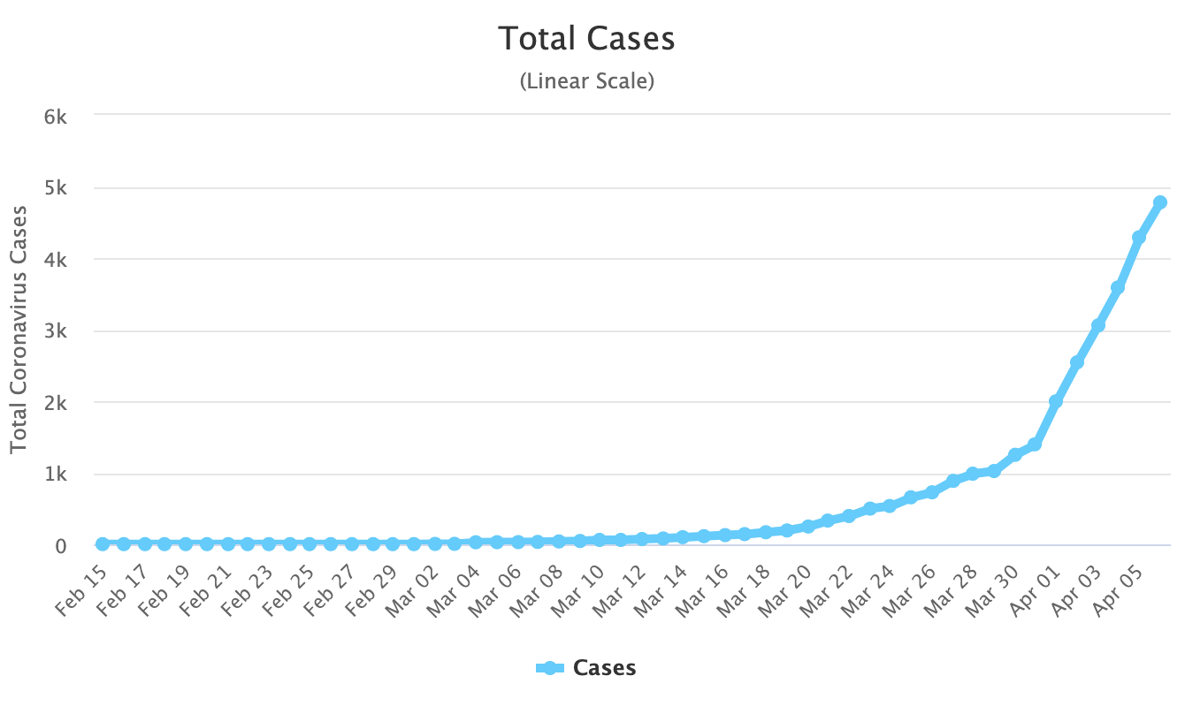
Coronavirus and Deep Learning

